Slide 1
CEOS WGCV Land Product Validation Sub-Group Overview
Joanne Nightingale, Jaime Nickeson
(Sigma Space Corp / NASA GSFC)
With input from LPV Focus Group Leads

Slide 2
Land Product Validation Sub-group
CEOS (Committee on Earth Observing Satellites)
WGCV (Working Group on Calibration and Validation)
Chair: Joanne Nightingale (NASA GSFC)
Vice-Chair: Gabriela Shaepman-Strub (University of Zurich)
NASA EOS Validation: Joanne Nightingale / Jaime Nickeson
7 Land Product Focus Groups
Established in June 2009
2 co-leads per group
~3-year terms

Slide 3
LPV Focus Groups
Focus Group | North America | Europe / Other
Land Cover * | Mark Friedl (Boston University) | Martin Herold (Wageningen University, NL & GOFC/GOLD)
Fire* (Active/Burned Area) | Luigi Boschetti (University of Maryland) | Kevin Tansey (University of Leicester, UK)
Biophysical (LAI*, ƒAPAR*) | Richard Fernandes (NR Canada) | Stephen Plummer (ESRIN, IT)
Surface Radiation (Reflectance, BRDF, Albedo*) | Crystal Schaaf (Boston University) | Gabriela Schaepman (University of Zurich, SW)
Land Surface Temperature | Simon Hook (JPL) | Jose Sobrino (University of Valencia, SP)
Soil Moisture* | Tom Jackson (USDA) | Wolfgang Wagner (Vienna Uni of Technology, AT)
Land Surface Phenology | Jeff Morisette (USGS) | TBD – TODAY!!!
* = Essential Climate Variable: Essential measurement for global earth observation and understanding long-term affects of climate change

Slide 4
LPV Objectives
To foster quantitative validation of higher level global land products derived from remotely sensed data, in a traceable way, and relay results so they are relevant to users
To increase the quality and efficiency of global satellite product validation by developing and promoting international standards and protocols for:
Field sampling
Scaling techniques
Accuracy reporting
Data / information exchange
To provide feedback to international structures (GEOSS) for:
Requirements on product accuracy and quality assurance (QA4EO)
Terrestrial ECV measurement standards
Definitions for future missions

Slide 5
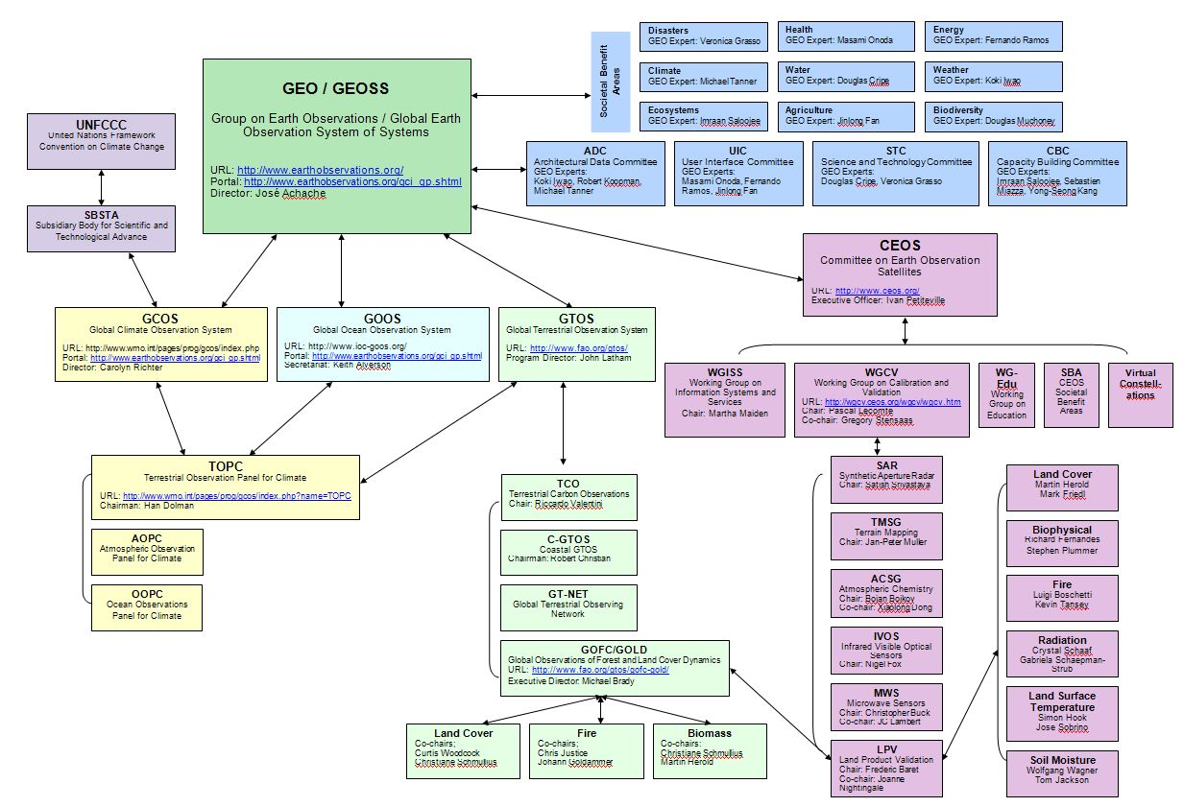
GEOSS Schematic
Linkages between International Programs concerned with Terrestrial Earth Observation

Slide 6
Role of Focus Groups
Engage community members (via listserv), update on progress, relevant meetings
Report back to LPV working group on activities, meetings, new products, funding mechanisms
Organize at least 1 topical workshop
Expand LPV activities, field sites, collaboration beyond North America and Europe!
Lead product inter-comparison activities
Lead the development and writing of “best practice” land product validation guidelines

Slide 7
Land Product Validation Protocols
“Best practice” for land product validation
Current knowledge
Available data
Tools and methods
Tested and repeatable
Peer-reviewed
CEOS endorsed/published
“Living” documents

Slide 8
Protocol Components
Template developed ~ may be tailored to suit each group
Process for CEOS endorsement / publication
Protocol key attributes:
Background / product definitions (ECV)
Accuracy assessment (comparison with in-situ, high resolution image reference data)
Existing data sets, field sites, sampling schemes, data quality issues
Spatial and temporal requirements for new datasets
Product Consistency (repeatability of products through time)
Address issues concerned with sensor calibration, data-reprocessing, algorithm refinement
Product Inter-comparison
Recommendations / Conclusions

Slide 9
Product Inter-comparisons
Many sensors = many similar products
Evaluation of spatial & temporal consistency between products
Highlight regions/temporal periods where detailed validation/evaluation studies are required
Provides information to data users about suitability of products for specific applications…

Slide 10
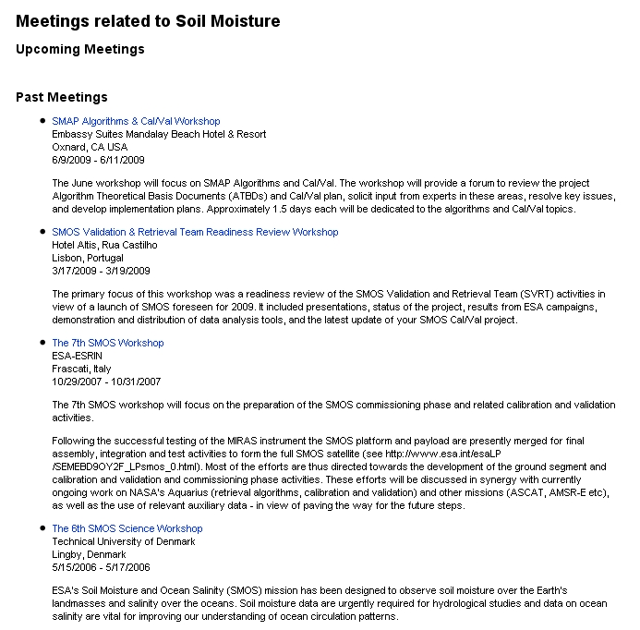
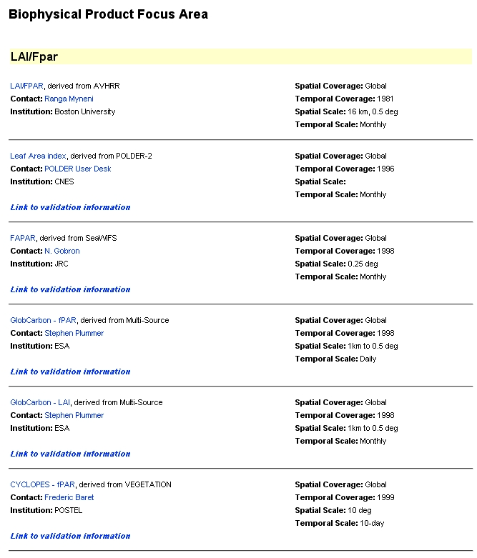
LPV Webpage
Updating product lists and background validation information per focus group
Background
Products
Meetings
Case Studies
Inter-comparisons

Slide 11
ISRSE 2011 - http://isrse34.org
International Symposium of Remote Sensing of Environment
Special Session on ground observation networks for operational land product validation (hyperspectral sensors / cameras / scaling issues etc)
April 10 – 14, 2011
Sydney, Australia!
Abstracts Due: September 1, 2010

Slide 12
Land Surface Phenology…… Jeff
Expand Initial LSP product inter-comparison
Issues to address:
How do metrics from different methods compare?
Does temporal smoothing effect phenological events – i.e. second, third seasons?
Affects of multi-day image compositing?
Scaling field samples to pixel resolution:
Vegetation heterogeneity
Field sampling schemes

Slide 13
Validation Stages
Consensus from LPV leads / MODIS land PI’s
Stage 1 | Product accuracy is assessed from a small (typically < 30) set of locations and time periods by comparison with in-situ or other suitable reference data.
Stage 2 | Product accuracy is estimated over a significant set of locations and time periods by comparison with reference in situ or other suitable reference data. Spatial and temporal consistency of the product and with similar products have been evaluated over globally representative locations and time periods. Results are published in the peer-reviewed literature.
Stage 3 | Uncertainties in the product and its associated structure are well quantified from comparison with in situ or other suitable reference data. Uncertainties are characterized in a statistically robust way over multiple locations and time periods representing global conditions. Spatial and temporal consistency of the product and with similar products have been evaluated over globally representative locations and periods. Results are published in the peer-reviewed literature.
Stage 4 | Validation results for stage 3 are systematically updated when new product versions are released and as the time-series expands.

